Slide 1
DTS205TC High Performance Computing
Lecture 10 MapReduce
Di Zhang, Spring 2024

Slide 2
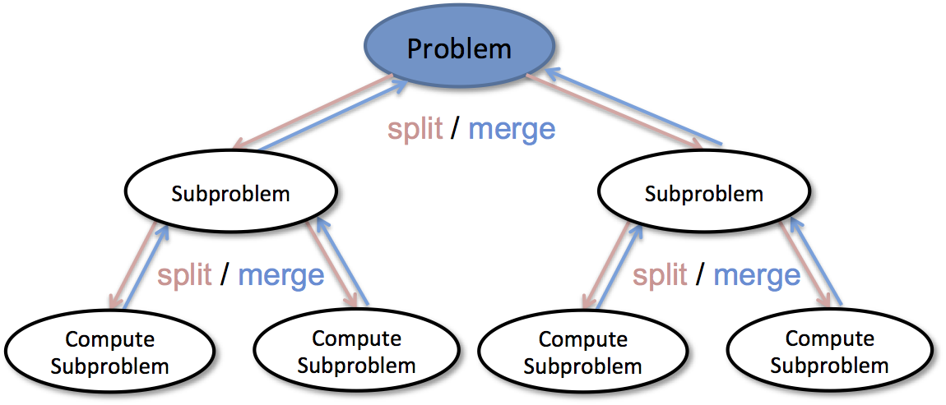
Divide-and-conquer
A divide-and-conquer algorithm recursively breaks down a problem into two or more sub-problems of the same or related type, until these become simple enough to be solved directly.
*Example: binary search, merge sort
Notes:
Divide-and-conquer algorithm

Slide 3
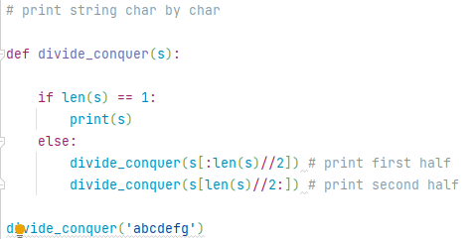
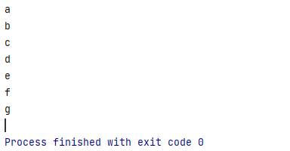
A simplest example
Key elements of Divide-and-conquer:
  Divisible problem:
    Print the string
  Split：
    Divide the string in half
  Conditions for Termination:
    Whether the length is 1
  Termination action:
    print

Slide 4
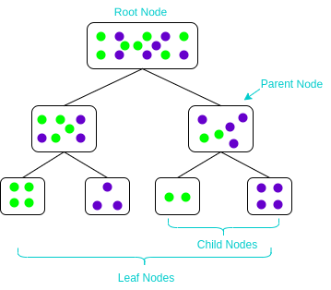
Example: Decision Tree
Key elements:
  Divisible problem:
    Build decision boundaries to ‘purify’ data
  Split：
    By information gain, the sample is divided into two piles
  Conditions for Termination:
    Whether it contains only one class
  Termination action:
    Returns the current subtree
Notes:
Divide-and-conquer algorithm

Slide 5
Parallelization
Remote Shared Memory
worker
New tasks
task
worker
worker
worker
In computing
idle
Use workpool to implement dynamic assignment of tasks in Divide-and-conquer
Unlike before, this is that each work is not only a consumer of the task, but also a producer; i.e., the number of tasks can be increased and is not a fixed value (in Lec. 6)

Slide 6
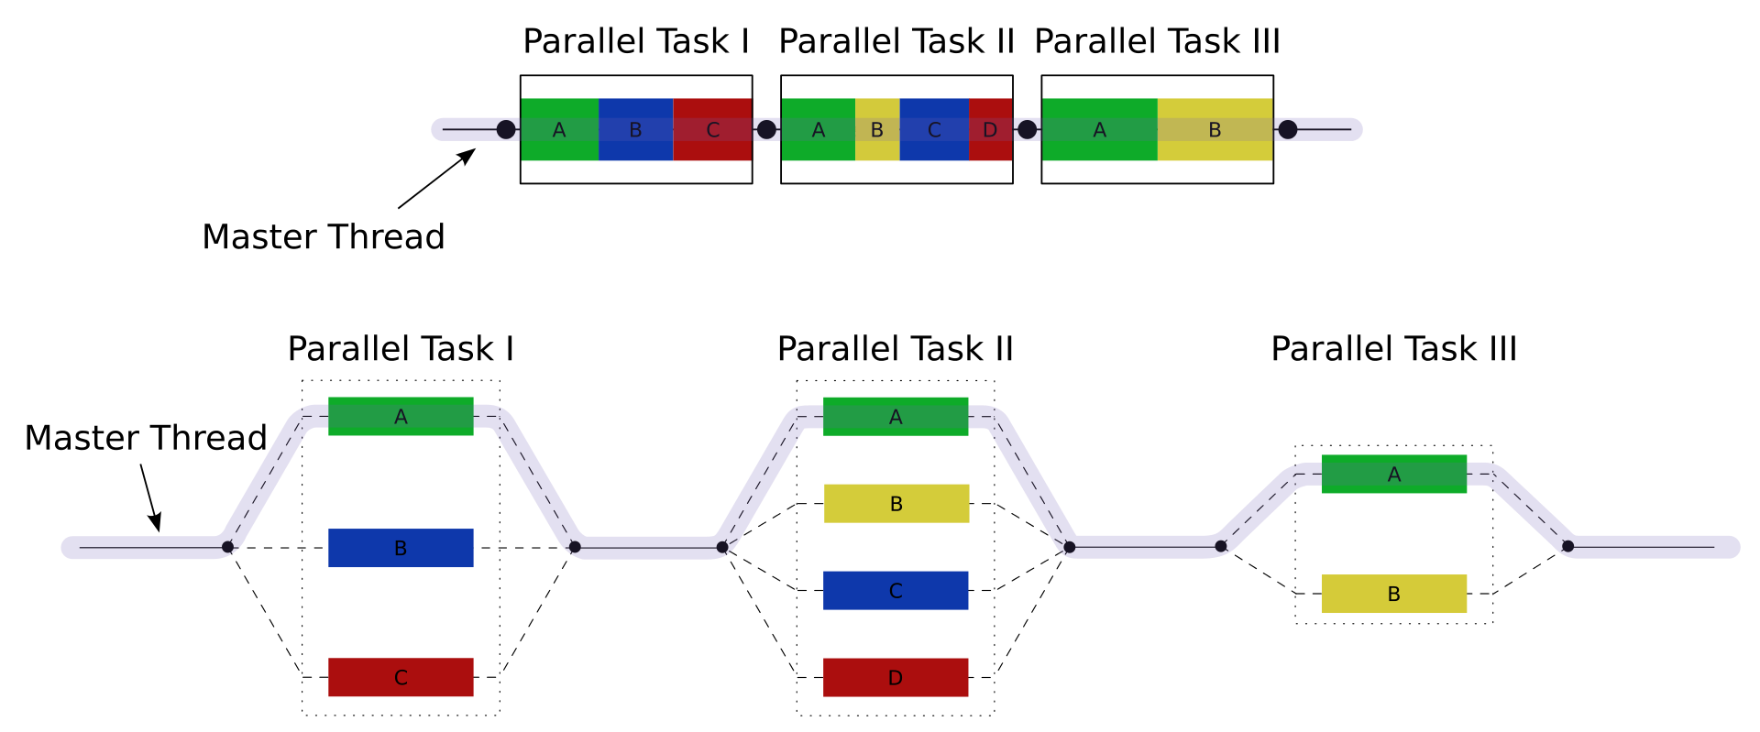
Fork-Join
Fork-Join executes branches in parallel at Fork points in the program, to "join" (merge) at a subsequent point and resume sequential execution
It is a simplified and iterative version of Divide-and-conquer
Fork-Join is the main model of parallel execution in the OpenMP

Slide 7
Compared to Embarrassingly Parallel
Embarrassingly Parallel
  Only with Fork, no Join!
The expressive capabilities of the three models are compared as below. They are each other’s subsets and supersets.
Divide-and-Conquer
Fork-Join
Embarrassingly
Parallel

Slide 8
Functional Programming Review
Functional operations do not modify data structures: They always create new ones
Original data still exists in unmodified form
Data flows are implicit in program design
Order of operations does not matter
Lists are primitive data types

Slide 9
Functional Programming Review
fun foo(l: int list) =
sum(l) + mul(l) + length(l)
Order of sum() and mul(), etc does not matter – they do not modify l

Slide 10
Functional Updates Do Not Modify Structures
fun append(x, lst) =
let lst' = reverse lst in
reverse ( x :: lst' )
The append() function above reverses a list, adds a new element to the front, and returns all of that, reversed, which appends an item.
But it never modifies lst!

Slide 11
Functions Can Be Used As Arguments
fun DoDouble(f, x) = f (f x)
It does not matter what f does to its argument; DoDouble() will do it twice.
What is the type of this function?

Slide 12
Map
map f lst: (’a->’b) -> (’a list) -> (’b list)
Creates a new list by applying f to each element of the input list; returns output in order.

Slide 13
Fold
fold f x₀ lst: ('a*'b->'b)->'b->('a list)->'b
Moves across a list, applying f to each element plus an accumulator. f returns the next accumulator value, which is combined with the next element of the list

Slide 14
fold left vs. fold right
Order of list elements can be significant
Fold left moves left-to-right across the list
Fold right moves from right-to-left
SML Implementation:
fun foldl f a [] = a
| foldl f a (x::xs) = foldl f (f(x, a)) xs
fun foldr f a [] = a
| foldr f a (x::xs) = f(x, (foldr f a xs))

Slide 15
Example
fun foo(l: int list) =
sum(l) + mul(l) + length(l)
How can we implement this?

Slide 16
Example (Solved)
fun foo(l: int list) =
sum(l) + mul(l) + length(l)
fun sum(lst) = foldl (fn (x,a)=>x+a) 0 lst
fun mul(lst) = foldl (fn (x,a)=>x*a) 1 lst
fun length(lst) = foldl (fn (x,a)=>1+a) 0 lst

Slide 17
A More Complicated Fold Problem
Given a list of numbers, how can we generate a list of partial sums?
e.g.: [1, 4, 8, 3, 7, 9] →
[0, 1, 5, 13, 16, 23, 32]

Slide 18
A More Complicated Map Problem
Given a list of words, can we: reverse the letters in each word, and reverse the whole list, so it all comes out backwards?
[“my”, “happy”, “cat”] -> [“tac”, “yppah”, “ym”]

Slide 19
map Implementation
fun map f [] = []
| map f (x::xs) = (f x) :: (map f xs)
This implementation moves left-to-right across the list, mapping elements one at a time
… But does it need to?

Slide 20
Implicit Parallelism In map
In a purely functional setting, elements of a list being computed by map cannot see the effects of the computations on other elements
If order of application of f to elements in list is commutative, we can reorder or parallelize execution
This is the “secret” that MapReduce exploits

Slide 21
Why Look at Functional Programming?
Let’s assume a long list of records: imagine if...
  We can parallelize map operations
  We have a mechanism for bringing map results back together in the fold operation
That’s MapReduce!
Observations:
  No limit to map parallelization since maps are independent
  We can reorder folding if the fold function is commutative and associative

Slide 22
MapReduce

Slide 23

Motivation: Large Scale Data Processing
Want to process lots of data ( > 1 TB)
Want to parallelize across hundreds/thousands of CPUs
… Want to make this easy

Slide 24
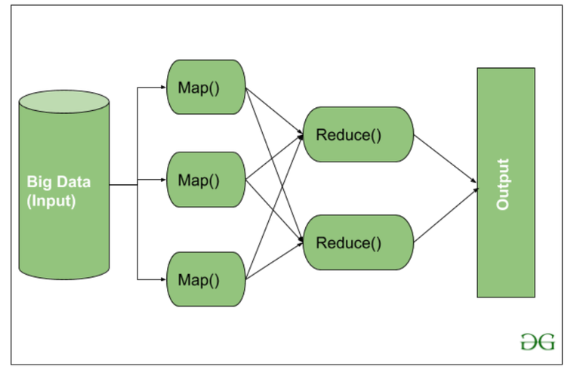
MapReduce
Automatic parallelization & distribution
Fault-tolerant
Provides status and monitoring tools
Clean abstraction for programmers

Slide 25
Programming Model
Borrows from functional programming
Users implement interface of two functions:
  map (in_key, in_value) ->
  (out_key, intermediate_value) list
  reduce (out_key, intermediate_value list) ->
  out_value list

Slide 26
Map
Records from the data source (lines out of files, rows of a database, etc) are fed into the map function as (key,value) pairs: e.g., (filename, offset).
map() produces one or more intermediate values along with an output key from the input.

Slide 27
Reduce
After the map phase is over, all the intermediate values for a given output key are combined together into a list
reduce() combines those intermediate values into one or more final values for that same output key
(in practice, usually only one final value per key)

Slide 28
Distributed Word Count
Split data
count
count
Split data
count
count
Very
big
data
merged
count
Split data
count
count
merge
Split data
count
count

Slide 29
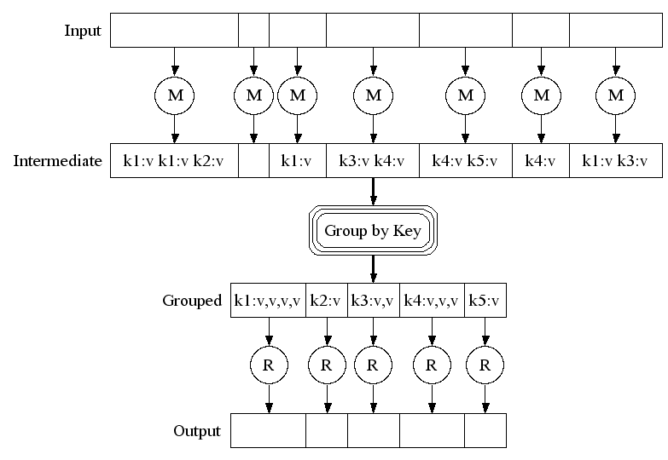
Partitioning Function

Slide 30
Example Word Count
Map
public static class MapClass extends MapReduceBase
implements Mapper {
private final static IntWritable one = new IntWritable(1);
private Text word = new Text();
public void map(WritableComparable key, Writable value,
OutputCollector output, Reporter reporter)
throws IOException {
String line = ((Text)value).toString();
StringTokenizer itr = new StringTokenizer(line);
while (itr.hasMoreTokens()) {
word.set(itr.nextToken());
output.collect(word, one);
}
}
}

Slide 31
Partitioning Function (2)
Default : hash(key) mod R
Guarantee:
  Relatively well-balanced partitions
  Ordering guarantee within partition

Slide 32
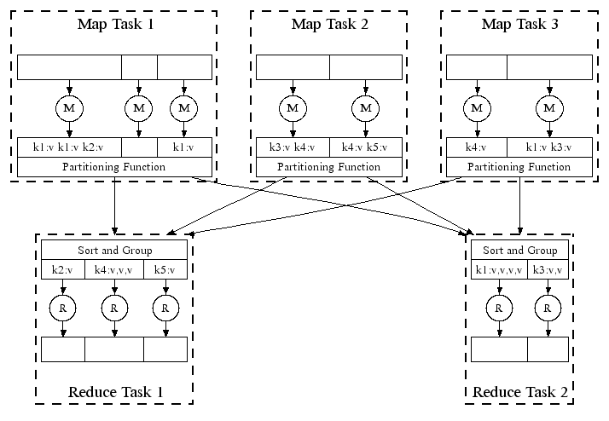
MapReduce in Parallel: Example

Slide 33
MapReduce
Distributed Grep
  Map:
    if match(value,pattern) emit(value,1)
  Reduce:
    emit(key,sum(value*))
Distributed Word Count
  Map:
    for all w in value do emit(w,1)
  Reduce:
    emit(key,sum(value*))

Slide 34
Implementation Overview
Typical cluster
  100’s/1000s of 2-CPU x86 machines, 2-4 GB of memory
  Storage is on local disks
  GFS: distributed file system manages data
  Job scheduling system: jobs made up of tasks, scheduler assigns tasks to machine

Slide 35
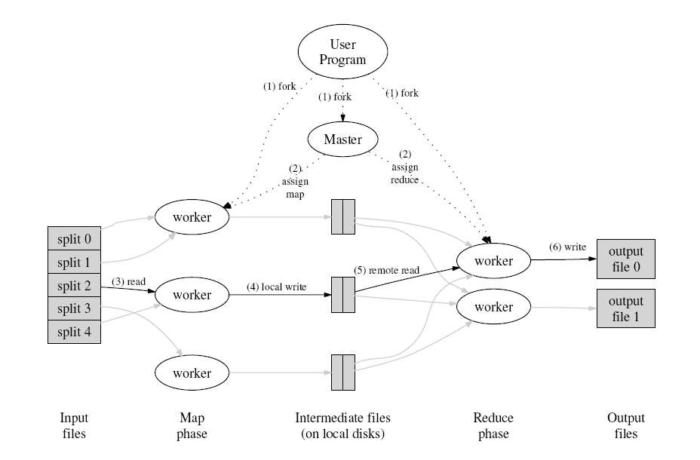
M
R
R

Slide 36
Execution
How is this distributed?
  Partition input key/value pairs into chunks, run map() tasks in parallel
  After all map()s are complete, consolidate all emitted values for each unique emitted key
  Now partition space of output map keys, and run reduce() in parallel
If map() or reduce() fails, reexecute!
Bottleneck: reduce phase can’t start until map phase is completely finished.

Slide 37
Locality
Master program divvies up tasks based on location of data: tries to have map() tasks on same machine as physical file data, or at least same rack
map() task inputs are divided into 64 MB blocks: same size as Google File System chunks

Slide 38
Fault Tolerance
Master detects worker failures
  Re-executes completed & in-progress map() tasks
  Re-executes in-progress reduce() tasks
Master notices particular input key/values cause crashes in map(), and skips those values on re-execution.
  Effect: Can work around bugs in third-party libraries!

Slide 39
Optimizations
No reduce can start until map is complete:
  A single slow disk controller can rate-limit the whole process
Master redundantly executes “slow-moving” map tasks; uses results of first copy to finish

Slide 40
Optimizations
“Combiner” functions can run on same machine as a mapper
Causes a mini-reduce phase to occur before the real reduce phase, to save bandwidth

Slide 41
MapReduce Conclusions
MapReduce has proven to be a useful abstraction
Greatly simplifies large-scale computations at Google
Functional programming paradigm can be applied to large-scale applications
Fun to use: focus on problem, let library deal w/ messy details

Slide 42
MapReduce Conclusions
MapReduce has proven to be a useful abstraction
Greatly simplifies large-scale computations at Google
Functional programming paradigm can be applied to large-scale applications
Fun to use: focus on problem, let library deal w/ messy details

